Slide 1
Information Enhanced Handheld Navigation Tool -AN AUGMENTED REALITY APPLICATION
STUDENTS
PRAVEEN. N (40408104084) SARAVANAN. C (40408104102) SRINIVASAN. V (40408104115)
GUIDE
S.ARANGANATHAN M.E. Assistant Professor (Senior Grade) Department of Computer Science and Engineering
BSA Crescent Engineering College

Slide 2
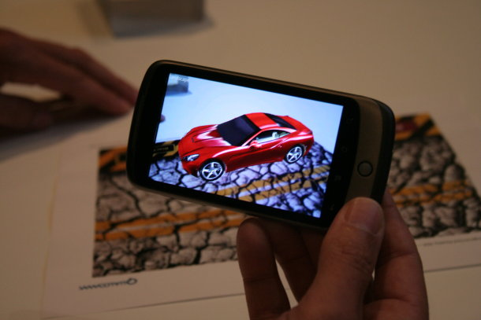
Augmented Reality(AR)
AR is a view that allows the user to see the real world with virtual objects superimposed on it.
Enhances a user's perception of and interaction with the real world.
AR supplements reality rather than completely replacing it.
AR provides a bridge between the digital and physical worlds.

Slide 3
Existing Work
Present systems rely much on object recognition.
Existing system considers the quality of the camera in the mobile device as an important factor.
Existing system uses servers to retrieve data based on information obtained.

Slide 4
Proposed Work
Providing a natural way of indicating information available at a particular location.
Augmenting the viewﬁnder with graphics that provide further information.
Achieving the user satisfaction through providing the data with respect to user’s Point Of Interest (POI).

Slide 5
Objective of the proposed work
The main objective of our project is to proactively push relevant information to the users to help speed up decisions, activities and to minimize tedious data entry by integrating applications with GPS and advanced sensors such as accelerometers, digital compasses and cameras.

Slide 6
Architecture

Slide 7
Modules
Tracker
Best POI Suggester
POI Manager
AR Delivery and Deployment
Interaction

Slide 8
Module Description
Tracker
Responds to changes in the user’s location and orientation.
Tracking is typically based on location sensors in the device such as GPS, compass and accelerometer allowing 6 degrees of freedom in displaying a digital object.
Best POI Suggester
Analyses the sensor and geo information i.e. location data and provides the best POI on comparison with POIs stored in database.

Slide 9
POI Manager
Gets the best POI and queries it to find its metadata.
AR deployment and delivery
Responsible for all objects superimposed over the camera.
Interaction
Provides access to Augmented representation of world, including Points of Interest(POI), objects and metadata.

Slide 10
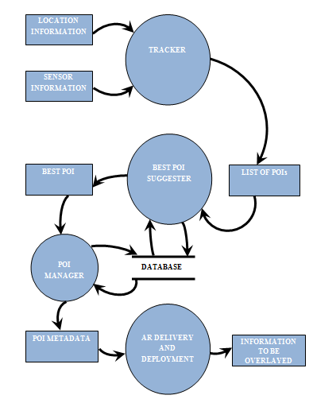
Data Flow Diagram

Slide 11
Hardware and Software requirements
PC
Mobile
Hardware | Specification
Processor | Pentium IV 2.6 GHz
RAM | 1 GB
Hardware/ Software | Specification
Form Factor | Any
Operating System | Android 2.3.3 or more
Software | Specification
Operating System | Windows XP or later
Development | Eclipse 3.6.2 or higher
SDK | Android SDK, Platform 2.3.3 or more

Slide 12
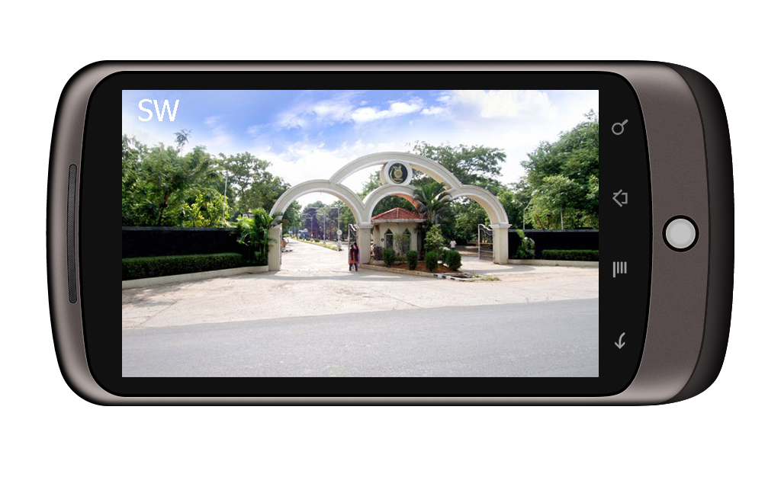
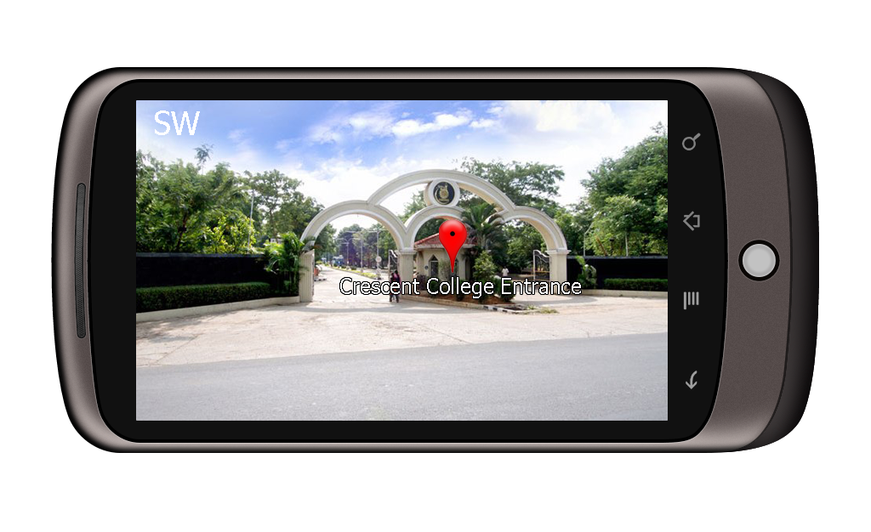
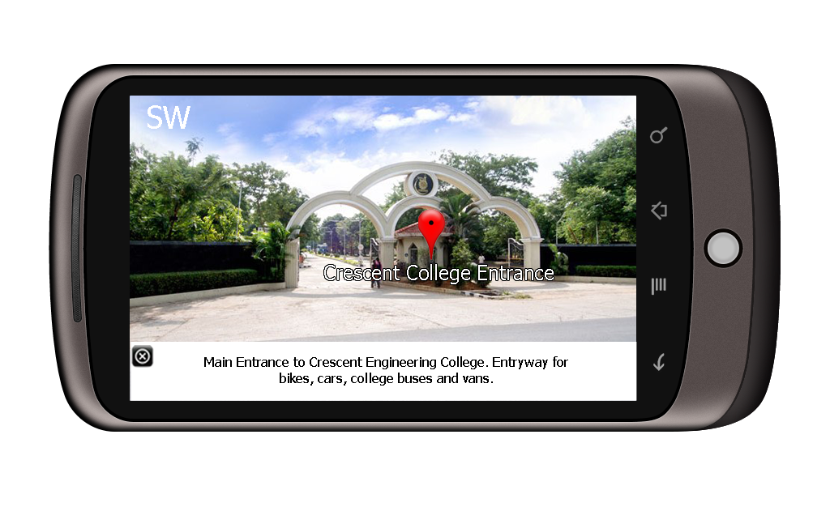
User Interface

Slide 13
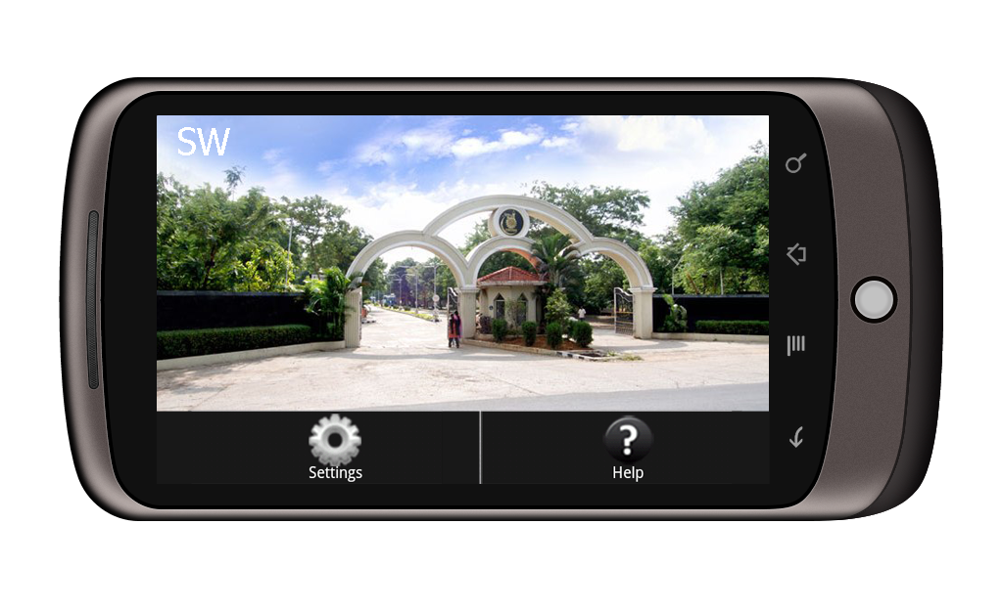
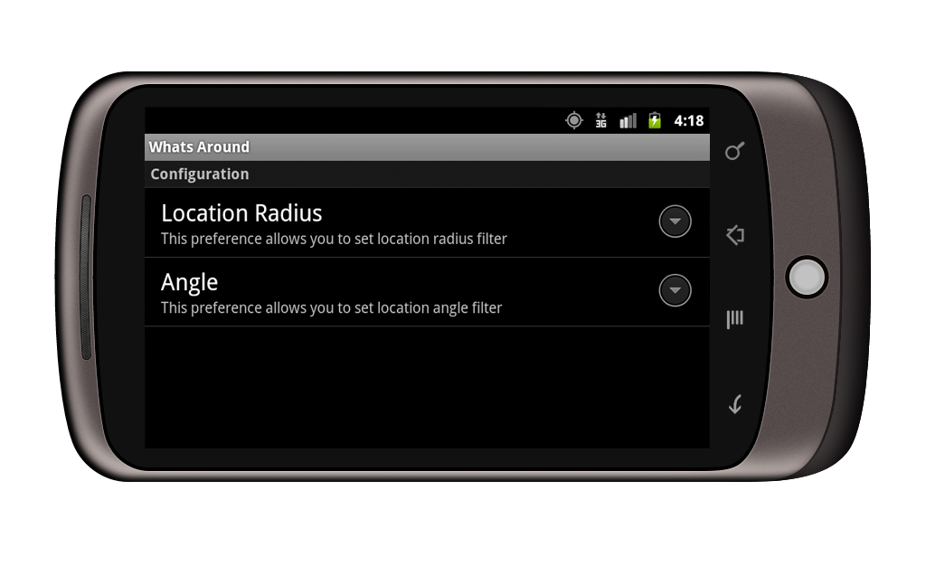
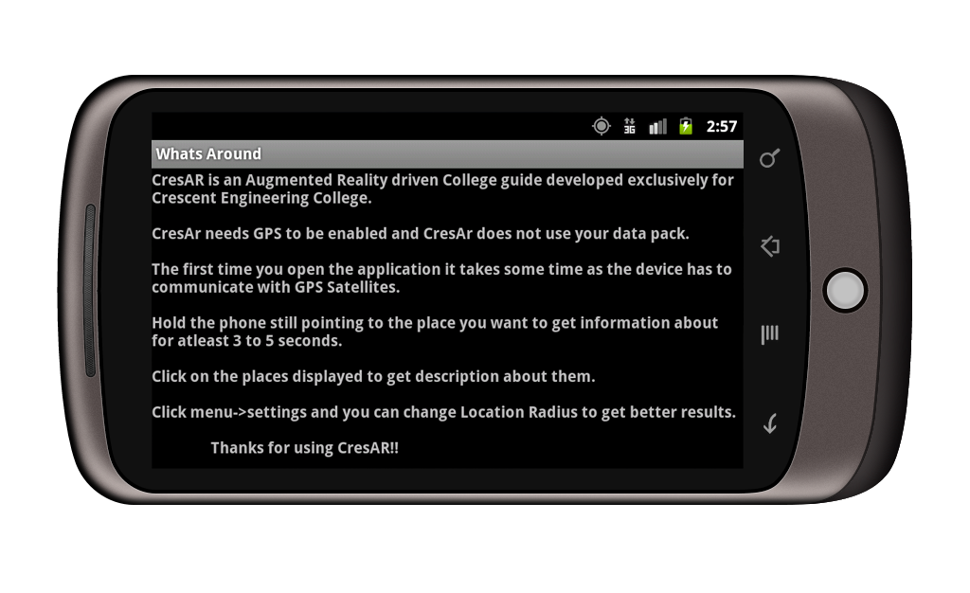
User Interface

Slide 14
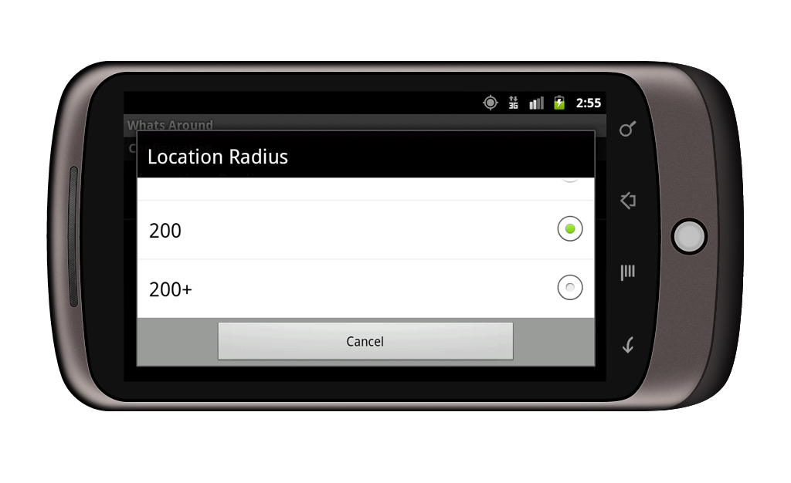
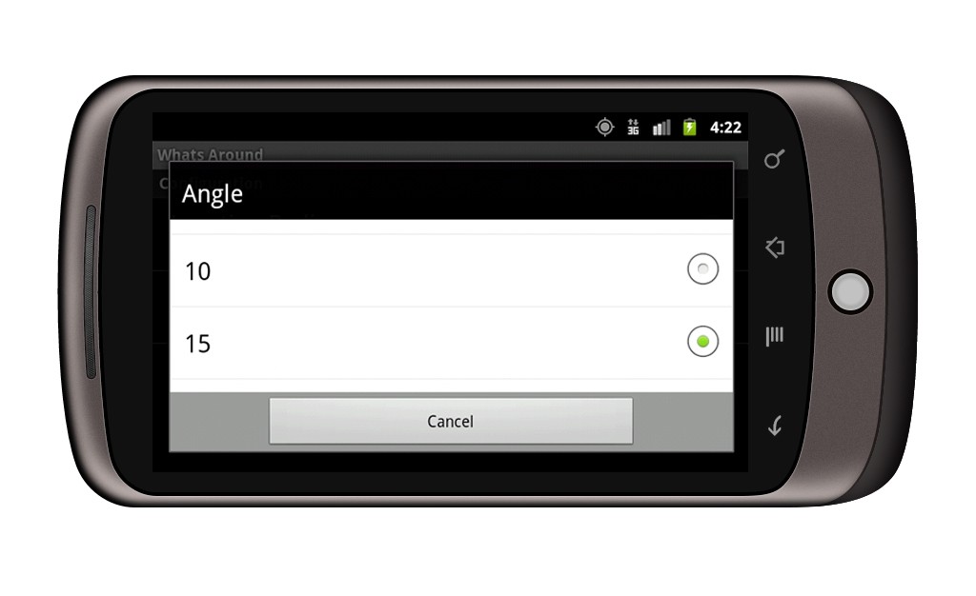
User Interface

Slide 15
Results
Augmented Reality
The markers are placed at the centre of the screen and there is no overlapping when the number of markers increases.
The application was tested on various Android devices with different screen resolutions such as Sony Ericsson Xperia Arc, Sony Ericsson Xperia Mini, Samsung Galaxy Y and Samsung Galaxy Ace and augmented reality was found to be working smoothly.

Slide 16
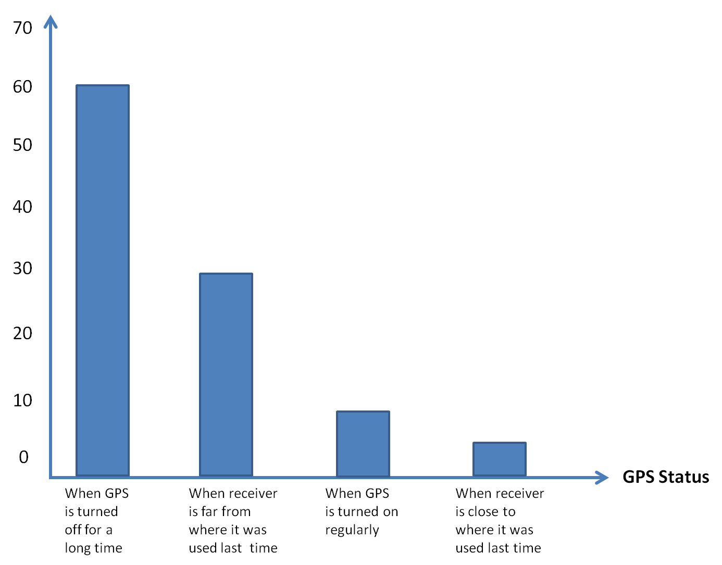
Localization
Time in seconds

Slide 17
Interest Point Detection

Slide 18
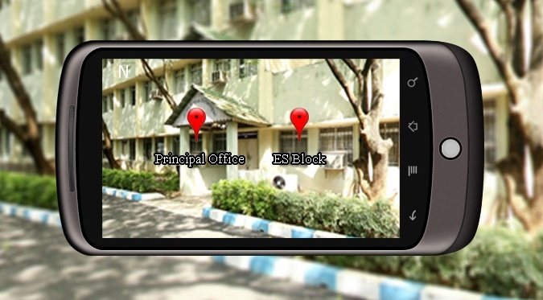

Where it outshines existing system?
Ability to discriminate foreground and obscured buildings.
Performs computation on a mobile phone, instead of sending the data to a remote server.

Slide 19
Future Enhancement
Adding a map to this application and enabling user to view and pull up information about buildings off campus can be a worthy extension to the project.
This application can be developed for other leading mobile operating systems too.

Slide 20
References
Mohamed El-Zayat, (2011) ‘Augmented Reality Platform for enhancing integration of virtual objects’, Proceedings of CESCG 2011: The 15th Central European Seminar on Computer Graphics.
Shane Porter, R., Michael Marner, R., Ross Smith, T., Joanne Zucco, E., Bruce Thomas, H. (2010) ‘Validating Spatial Augmented Reality for Interactive Rapid Prototyping', Mixed and Augmented Reality (ISMAR), 9th IEEE International Symposium, pp.265-266.
Miyashita, T., Meier, P., Tachikawa, T., Orlic, S., Eble , T., Scholz, V., Gapel, A., Gerl, O., Arnaudov, S., Lieberknecht, S. (2008) ‘An Augmented Reality Museum Guide’, Mixed and Augmented Reality (ISMAR), 7th IEEE/ACM International Symposium, pp.103-106.
Steffen Gauglitz, Tobias Höllerer, Matthew Turk, (2010) ‘Evaluation of Interest Point Detectors and Feature Descriptors for Visual Tracking’, International Journal of Computer Vision (IJCV), Vol.94, No.3, pp.335-360.
Gabriel Takacs, (2008) ‘Outdoors Augmented Reality on Mobile phone using Loxel-Based Visual Feature Organization’, MIR '08 Proceedings of the 1st ACM international conference on Multimedia information retrieval, pp.427.

Slide 21
THANK YOU

